Slide 1


Death by a thousand cuts How to secure Windows network protocols and frustrate your next pentester

Slide 2





whoami
https://0xAsh.io
@_bin_Ash
@0xAsh
Asher Andree
Senior Penetration Tester
CRTO | OSCP | eJPT
Learn more about us: https://risk3sixty.com/penetration-testing

Slide 3
Let’s get started

Slide 4
What will we be covering today?
1
Protecting our Protocols

Slide 5
What will we be covering today?
1
Protecting our Protocols
2
Relaying/Hardening Services

Slide 6
What will we be covering today?
1
Protecting our Protocols
2
Relaying/Hardening Services
3
Everything Else

Slide 7
Part 0: Context

Slide 8
Why does any of this matter?

Slide 9
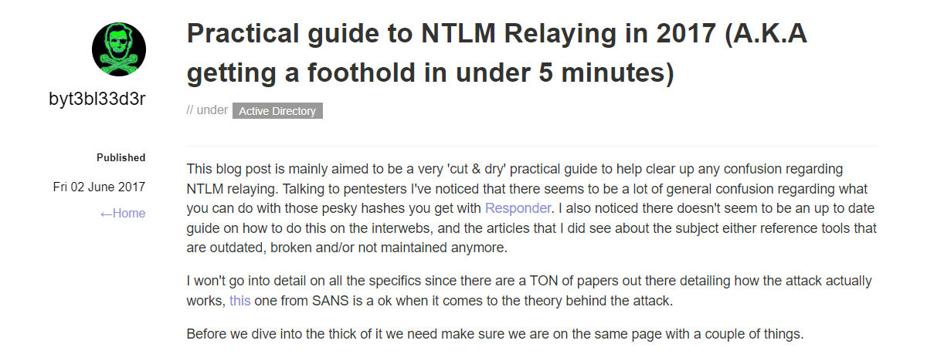
My History
Like many… my journey started with this blog… [1]

Slide 10

2019

Slide 11

2020 - 2021

Slide 12

2022

Slide 13
This sucks.

Slide 14
This sucks for you.

Slide 15
This sucks for you.
$$$

Slide 16
This sucks for you.
$$$ Time

Slide 17
This doesn’t suck for me.

Slide 18
My life should suck.

Slide 19
I want you to win.

Slide 20
You can think of this talk as a free portion of an internal network pentest
It’s by no means all encompassing
But it for sure will make your next internal pentester’s life suck a little
Their life should suck a little
You should be equipped to win
Also… be sure to check out the further reading section near the end

Slide 21
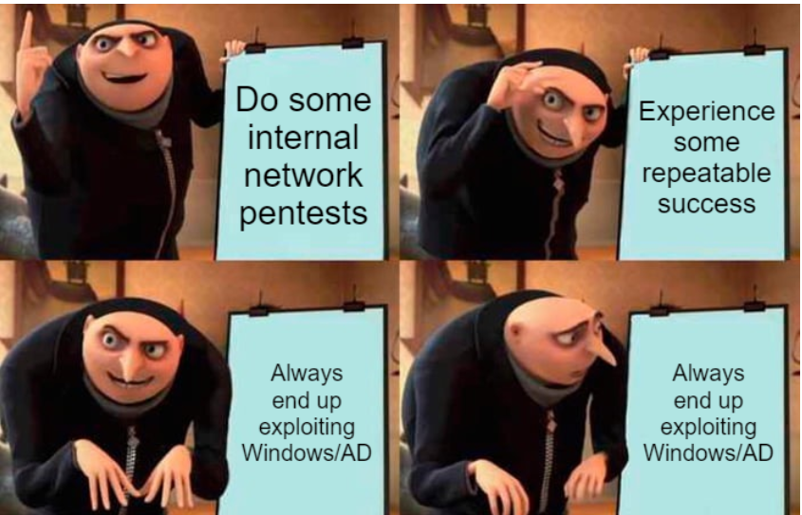

Slide 22
Part 1: Protecting Our Protocols

Slide 23
One note…

Slide 24
NTLM

Slide 25
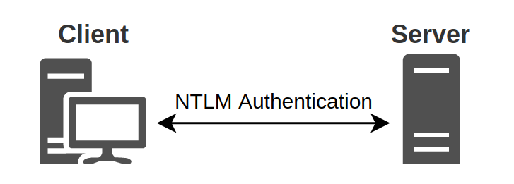
NTLM Authentication
NT Lan Manager (NTLM) -> Developed in 1993
NTLMv1 and NTLMv2 -> Both vulnerable to MitM attacks
Can be cracked offline
Can also be relayed to other services
Disable NTLM and only use Kerberos? Good luck
Hackndo: NTLM Relay [2]

Slide 26
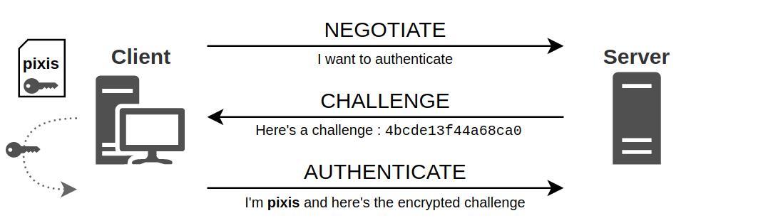
NTLM Authentication
Client requests authentication with server
Server issues a challenge
Client encrypts the issued challenge with its secret -> sends it back to server
Hackndo: NTLM Relay [2]

Slide 27
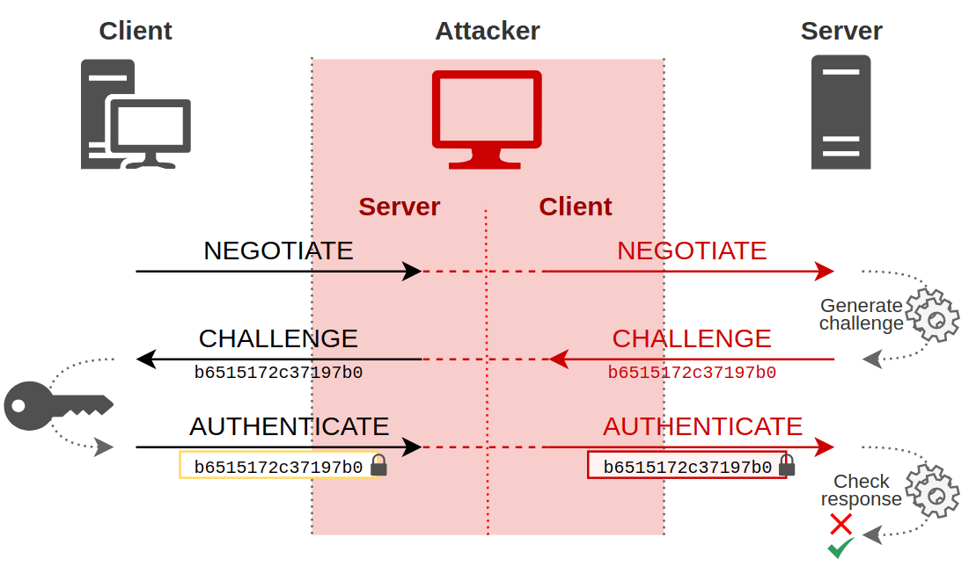
Hackndo: NTLM Relay [2]

Slide 28
Poisoning

Slide 29
Link-Local Multicast Name Resolution (LLMNR)

Slide 30
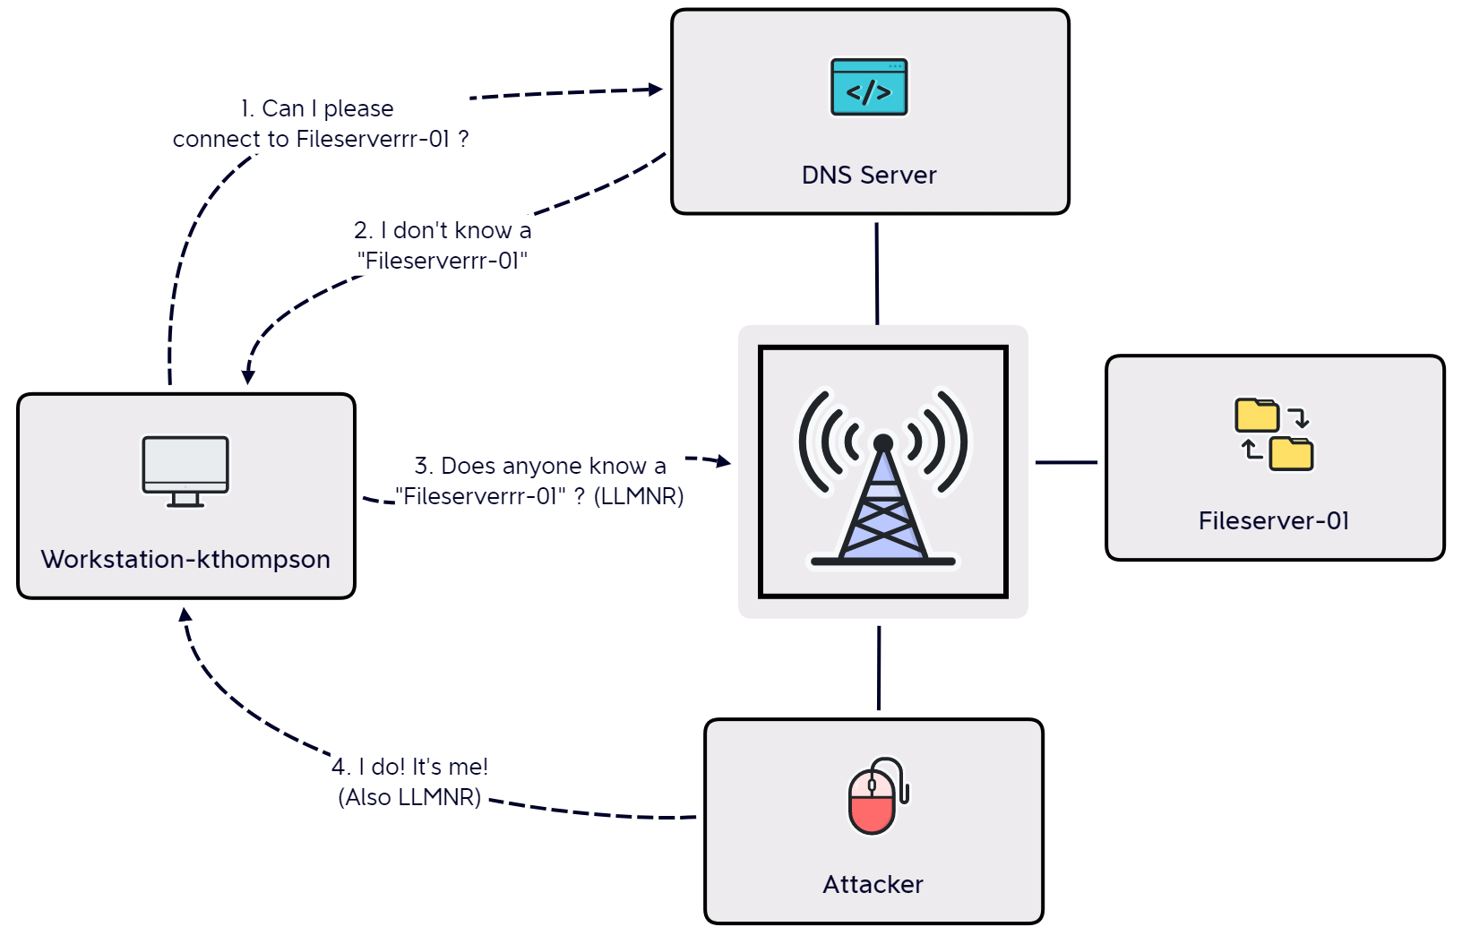

Slide 31
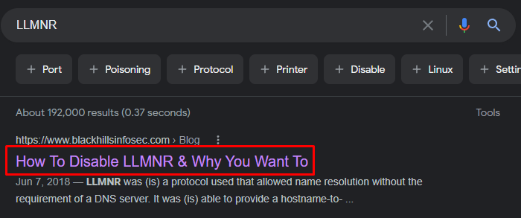
Link-Local Multicast Name Resolution (LLMNR)
How To Disable LLMNR & Why You Want To [3]

Slide 32
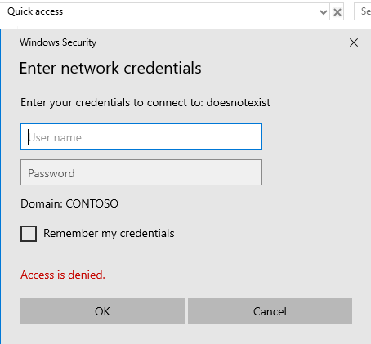
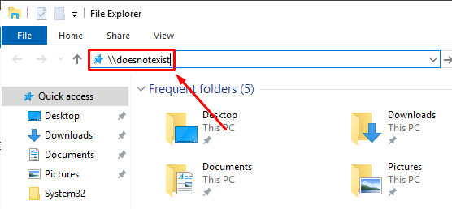
LLMNR

Slide 33
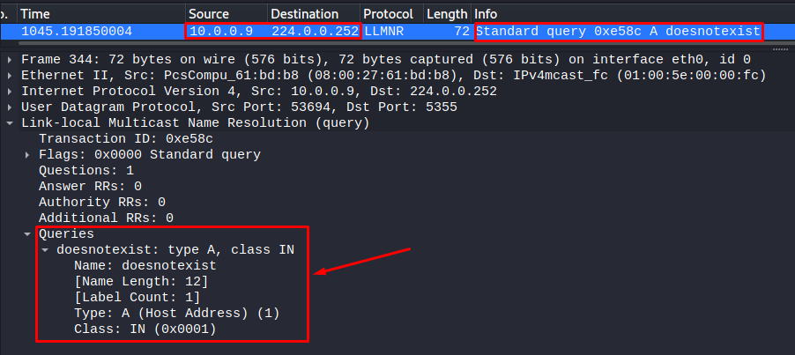
LLMNR

Slide 34
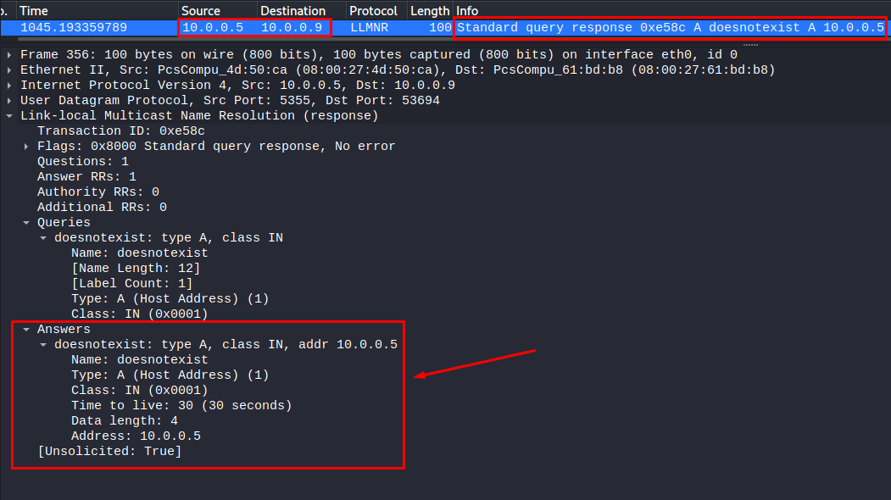
LLMNR

Slide 35
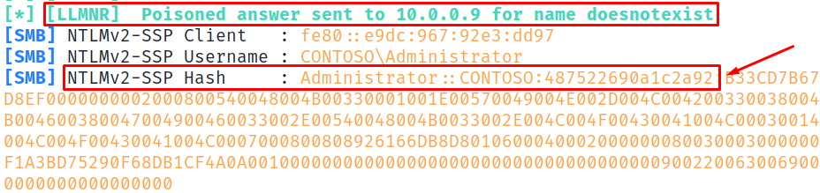
Poisoning LLMNR

Slide 36
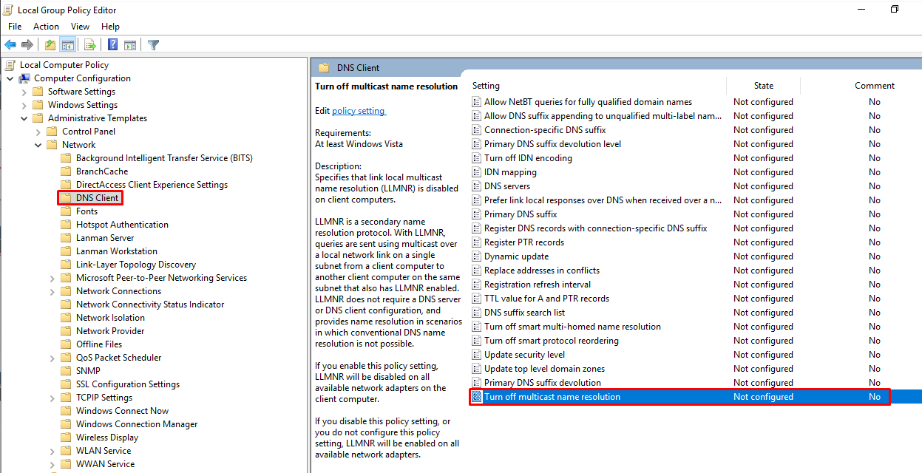
Cool, How do I fix it? (LLMNR)
Computer Configuration -> Network -> DNS Client -> Turn off multicast name resolution -> Enabled

Slide 37
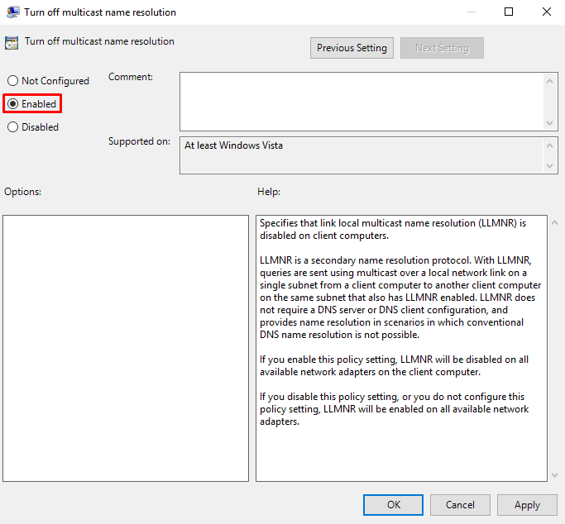
Cool, How do I fix it? (LLMNR)
Computer Configuration -> Network -> DNS Client -> Turn off multicast name resolution -> Enabled

Slide 38
We won! Thanks for coming

Slide 39
NetBIOS Name Service (NBT-NS)

Slide 40
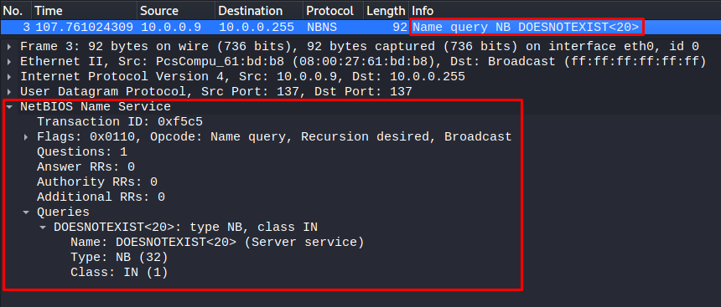
NetBios (NBT-NS)

Slide 41
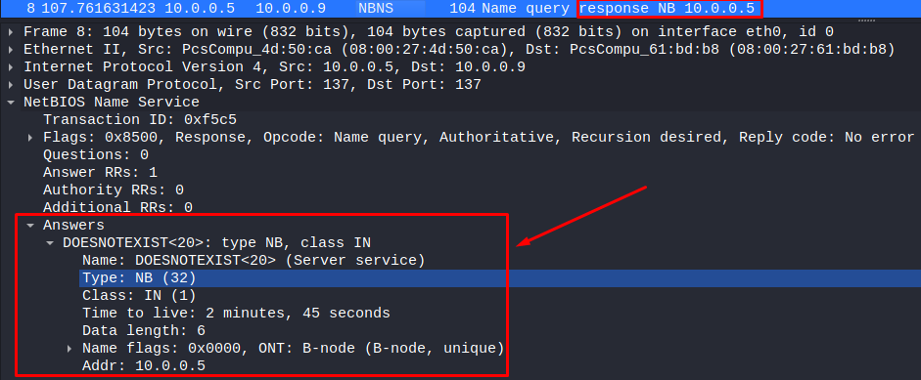
NetBios (NBT-NS)

Slide 42
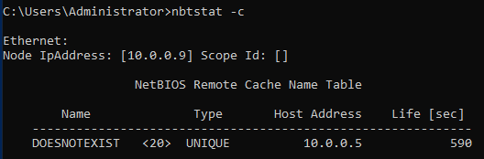
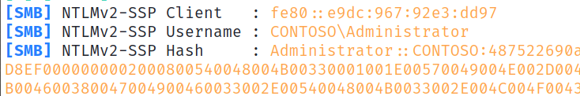
What does this do for us?
Poisoned table
Authentication pointed towards us!

Slide 43
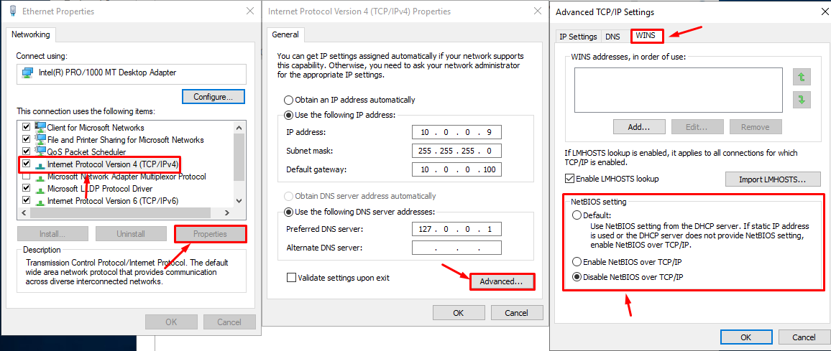
Cool, how do I fix it? Part 2

Slide 44
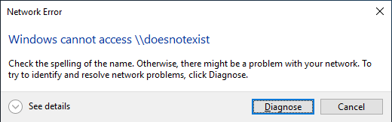
Cool, how do I fix it? Part 2
Via PowerShell [4]:
Set-ItemProperty HKLM:\SYSTEM\CurrentControlSet\services\NetBT\Parameters\Interfaces\tcpip*
-Name NetbiosOptions -Value 2

Slide 45
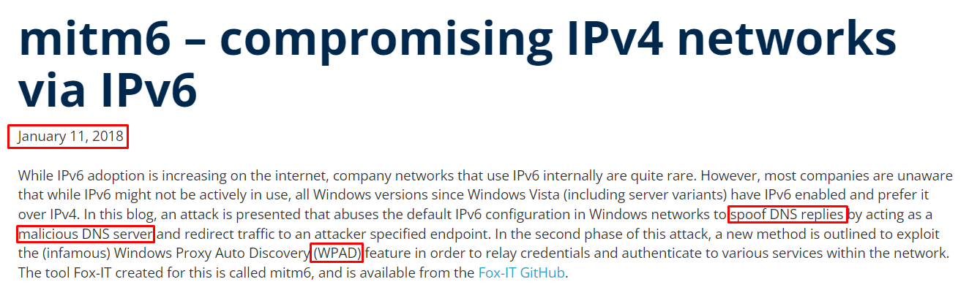
DHCPv6
Fox IT: mitm6 – compromising IPv4 networks via IPv6 [5]

Slide 46
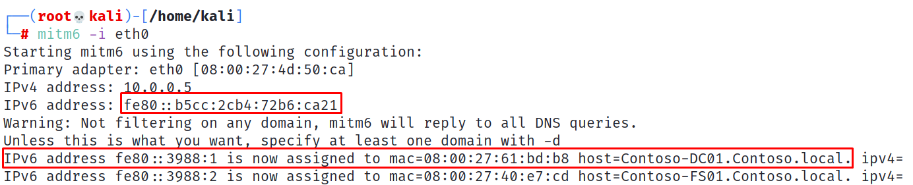
DHCPv6
Periodically requests IPv6 configuration via DHCPv6
IPv6 DNS > IPv4 DNS
Can only advertise yourself as a gateway… limited adverse impacts to client environment since hosts won’t try to talk to assets IPv6 hosts outside their network segment

Slide 47
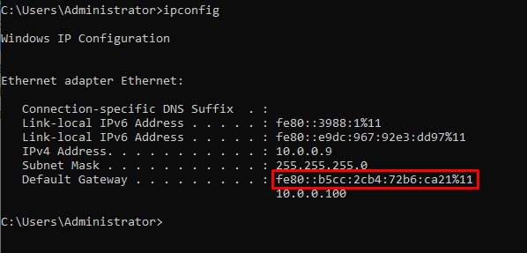
DHCPv6
Default Gateway has been replaced!

Slide 48
Windows Proxy Auto Discovery (WPAD)
The curious case of WPAD
Wpad.dat file used to configure an internal proxy server
As of 2016 WPAD is only requested via DNS… no LLMNR
Wait… we are DNS aren’t we?
Time to start relaying! More on this soon

Slide 49
First let’s sort out DHCPv6 + WPAD
LMG Security: Mitigating IPv6 Poisoning Attacks [6]
PowerShell:
Set-NetIPInterface –AddressFamily IPv6 –InterfaceIndex $(Get-NetIPInterface –AddressFamily IPv6 | Select-Object –ExpandProperty InterfaceIndex)
–RouterDiscovery Disabled –Dhcp Disabled
LMG Security: Mitigating IPv6 Poisoning Attacks [6]

Slide 50
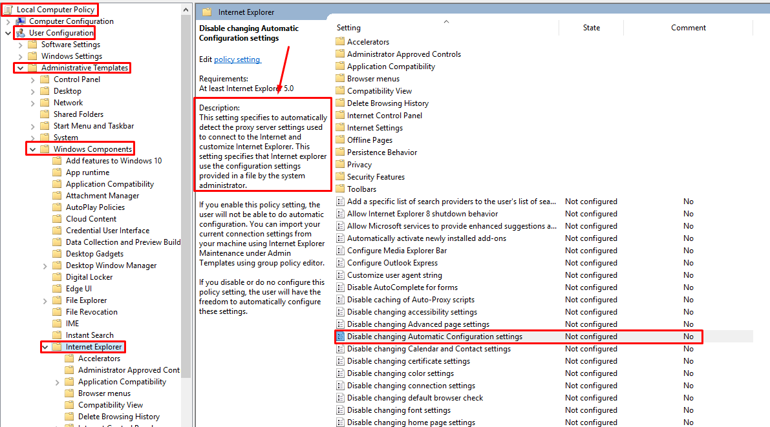
WPAD
User Configuration -> Administrative Templates -> Windows Components -> Internet Explorer -> Disable changing Automatic Configuration settings -> Enabled

Slide 51
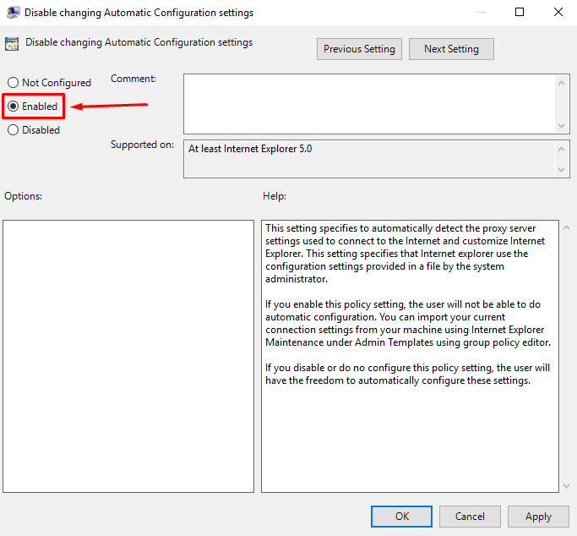
WPAD
User Configuration -> Administrative Templates -> Windows Components -> Internet Explorer -> Disable changing Automatic Configuration settings -> Enabled

Slide 52
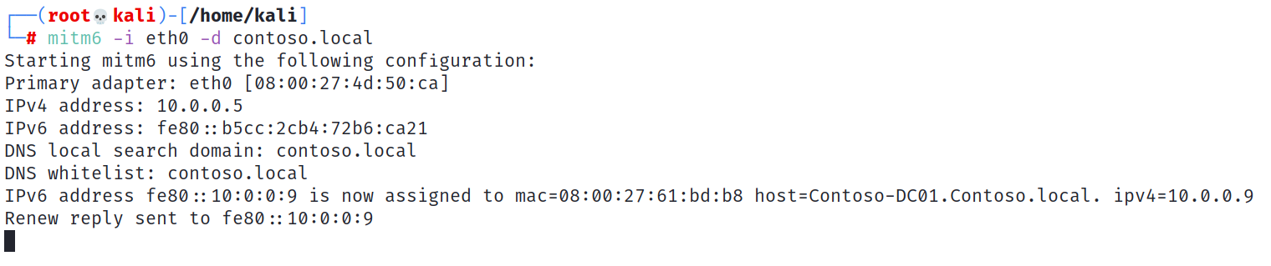
WPAD
No more WPAD!

Slide 53


Slide 54

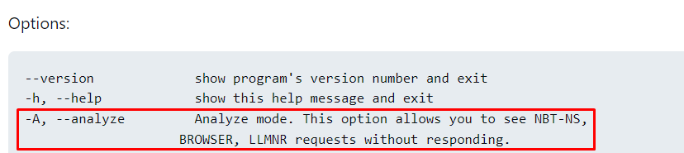
Operational Footnotes
Responder
Start out in Analyze mode
Responder.conf is your friend
Filter out “sus” traffic
AND/OR packet capture (Wireshark, tshark, tcpdump)

Slide 55
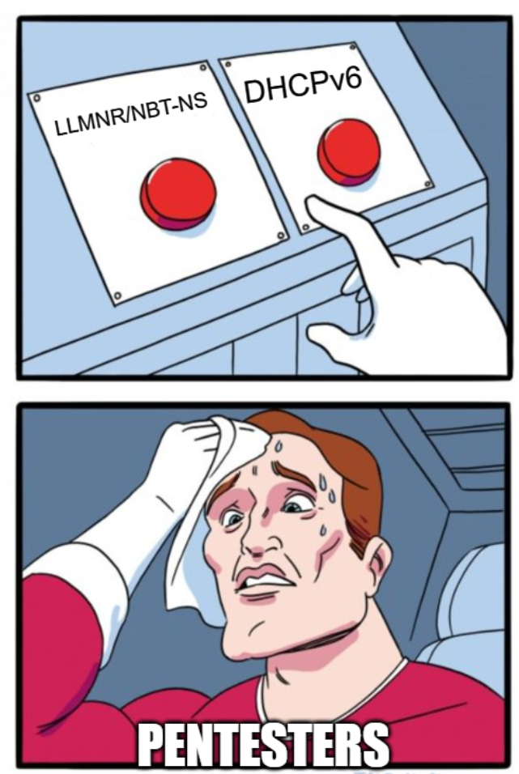
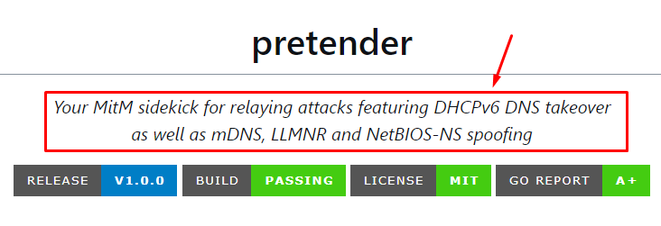
Operational Footnotes
RedTeamPentesting / Pretender [7]

Slide 56
Part 2: Protecting/Hardening Services

Slide 57

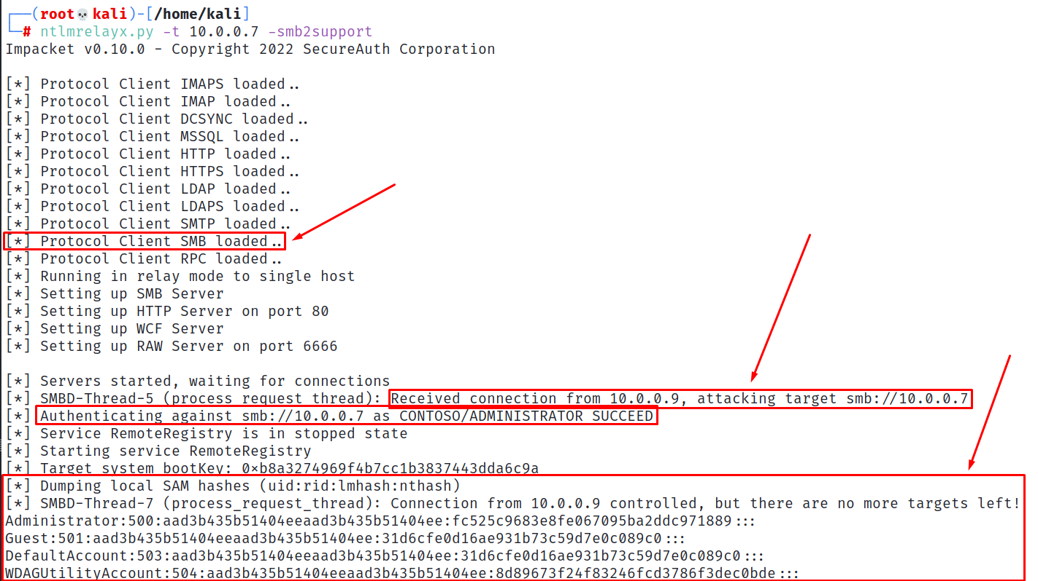
Server Message Block (SMB)

Slide 59
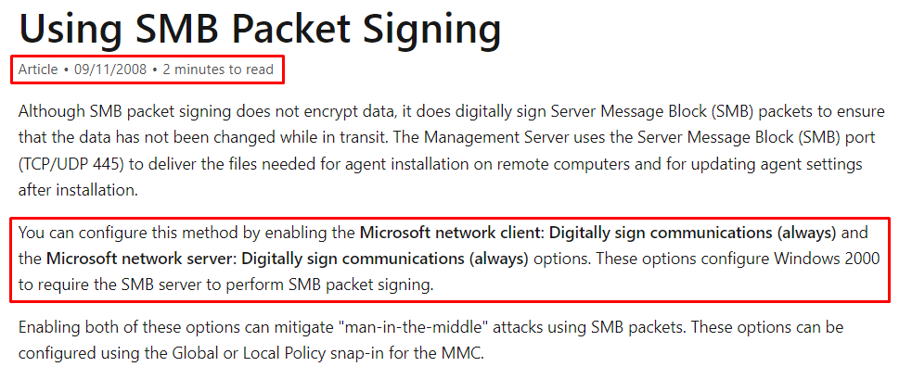
Hardening SMB
Super easy! [8]

Slide 60
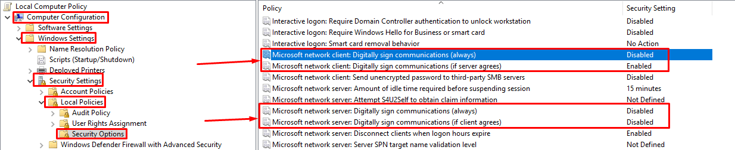
Hardening SMB
Computer Configuration -> Windows Settings -> Security Settings -> Local Policies -> Security Options
Microsoft network server: Digitally sign communications (ALWAYS)

Slide 61
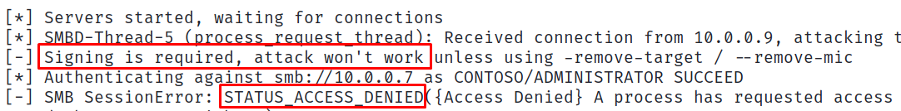
Hardening SMB
Enabling SMB signing across the board is BY FAR the biggest return on investment a single configuration can offer.

Slide 62
Lightweight Directory Access Protocol (LDAP)
There are caveats…

Slide 63
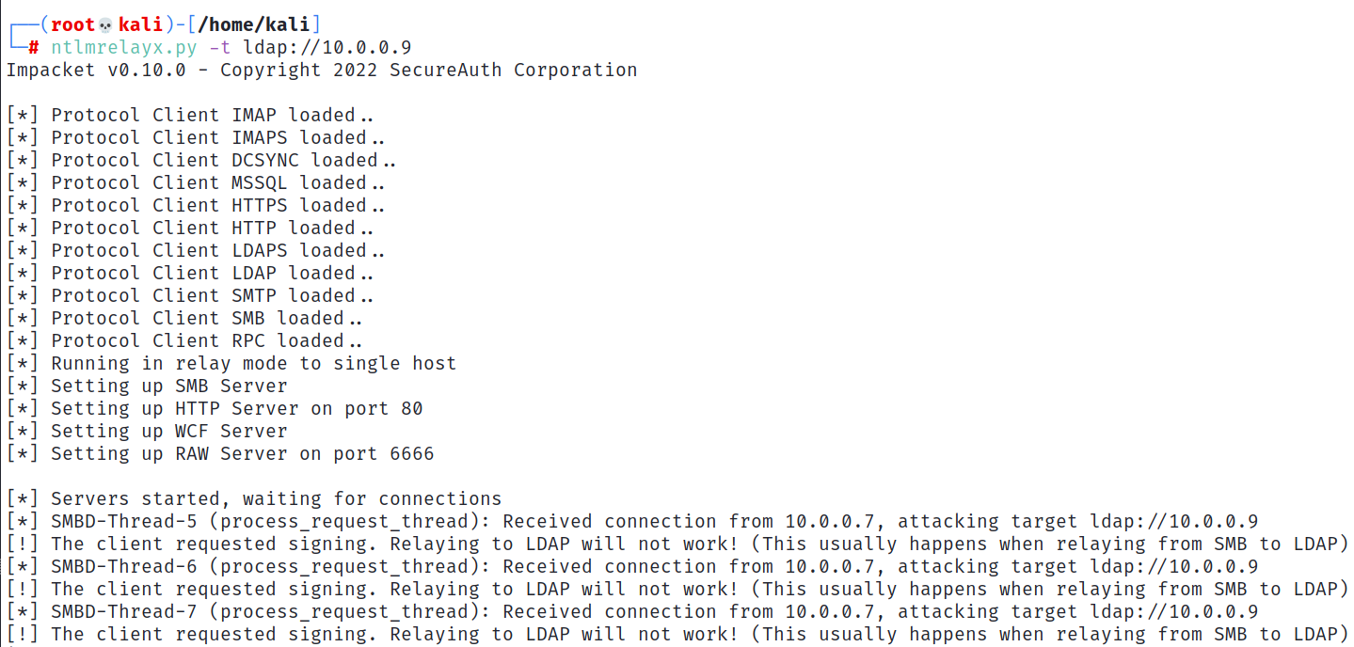
Lightweight Directory Access Protocol (LDAP)
SMB -> LDAP will likely not work

Slide 64
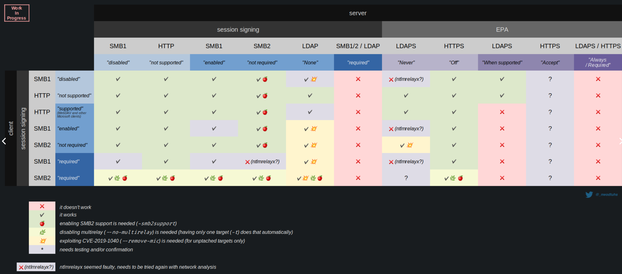
Lightweight Directory Access Protocol (LDAP)
There are caveats…
The Hacker Recipes: Relay [9]
@_nwodtuhs [10]

Slide 65
Lightweight Directory Access Protocol (LDAP)
There are caveats…
It gets complicated quickly

Slide 66
Lightweight Directory Access Protocol (LDAP)
There are caveats…
It gets complicated quickly
Prioritize by most common attack paths first

Slide 67
Lightweight Directory Access Protocol (LDAP)
What can we do?
Edit Active Directory ACLs
Create computer accounts
Configure Resource-Based Constrained Delegation (RBCD)
Setup Shadow Credentials
Mitigations? (tread carefully)
LDAP Signing
LDAP Channel Binding

Slide 68
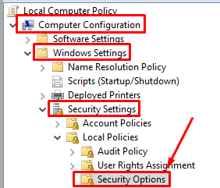
LDAP Signing
Computer Configuration
-> Windows Settings
-> Security Settings
-> Local Policies
-> Security Options
-> Network security: LDAP client signing requirements
-> Require Signing

Slide 69
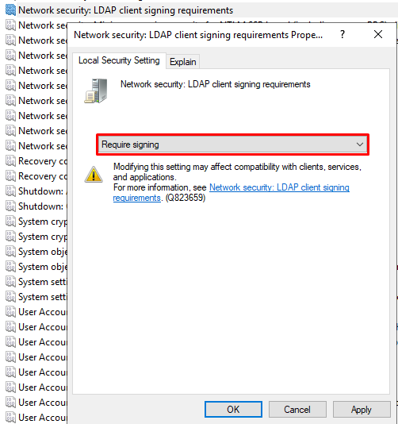
LDAP Signing
Computer Configuration
-> Windows Settings
-> Security Settings
-> Local Policies
-> Security Options
-> Network security: LDAP client signing requirements
-> Require Signing

Slide 70
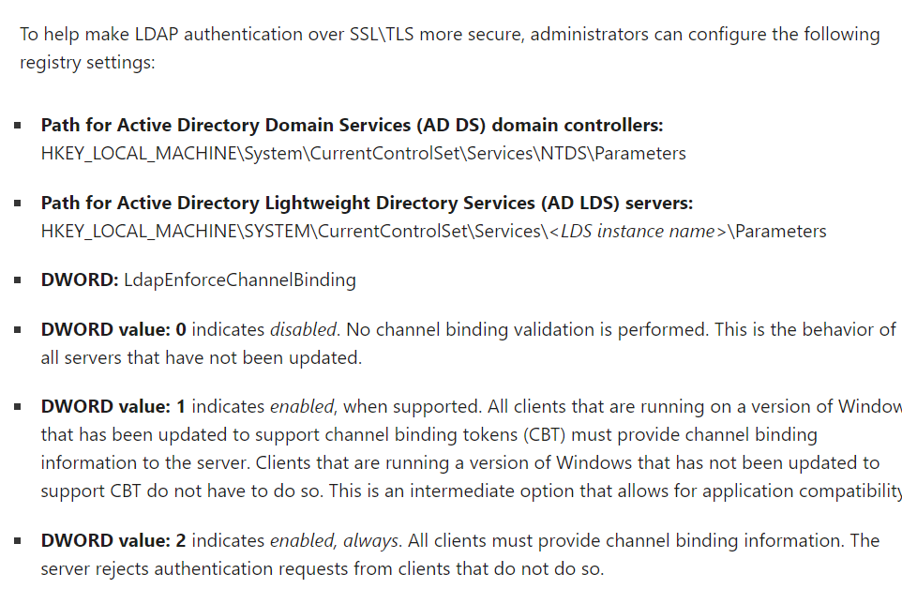
LDAP Channel Binding
Use the LdapEnforceChannelBinding registry entry to make LDAP authentication over SSL/TLS more secure [11]

Slide 71
Active Directory Certificate Services (ADCS)
Latest and greatest thing to relay to
Service used to generate certificates that can be used for authentication to services
Persistence
Worth an entire talk of its own

Slide 72
Active Directory Certificate Services (ADCS)
“Certified Pre-Owned” [12] -> Mid -2021
Research by Will Schroeder and Lee Christensen at SpecterOps
“AD CS is Microsoft’s PKI implementation that integrates with existing Active Directory forests, and provides everything from encrypting file systems, to digital signatures, to user authentication (a large focus of this paper), and more.”
Attack dubbed “ESC8” is what we most commonly use with relaying attacks

Slide 73
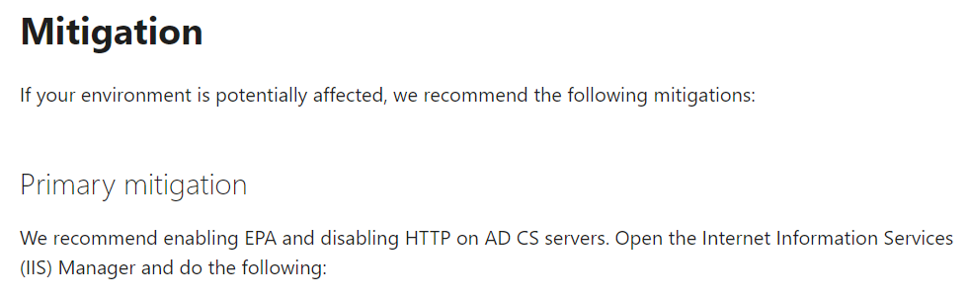
Active Directory Certificate Services (ADCS)
Wayyyyy too much detail…. Let’s just work on fixing it!
Extended Protection for Authentication (EPA)
KB5005413: Mitigating NTLM Relay Attacks on Active Directory Certificate Services (AD CS)[13]

Slide 74
We’ve protected all! (kinda)

Slide 75
Elephant in the room…

Slide 76
Coerced Authentication
Windows hosts really like to authenticate to stuff

Slide 77
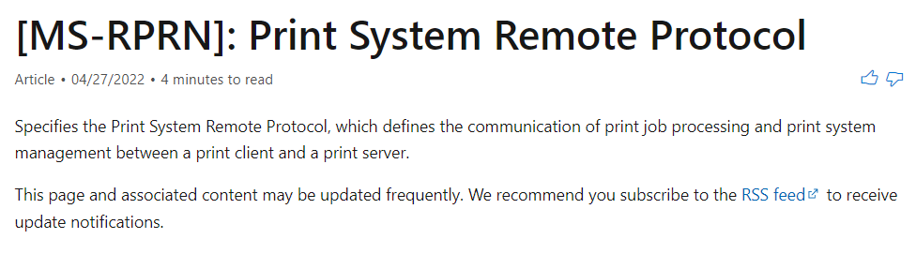
Coerced Authentication
Windows hosts really like to authenticate to stuff

Slide 78
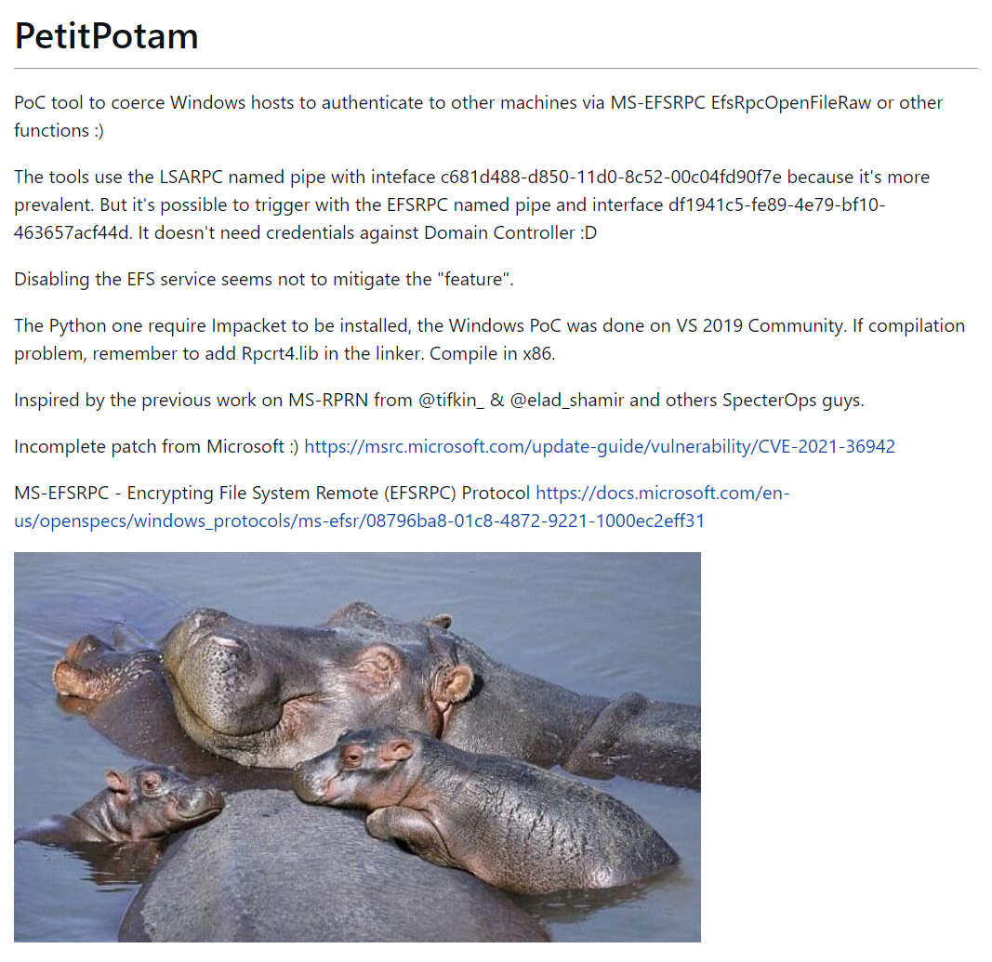
Coerced Authentication
Windows hosts really like to authenticate to stuff

Slide 79
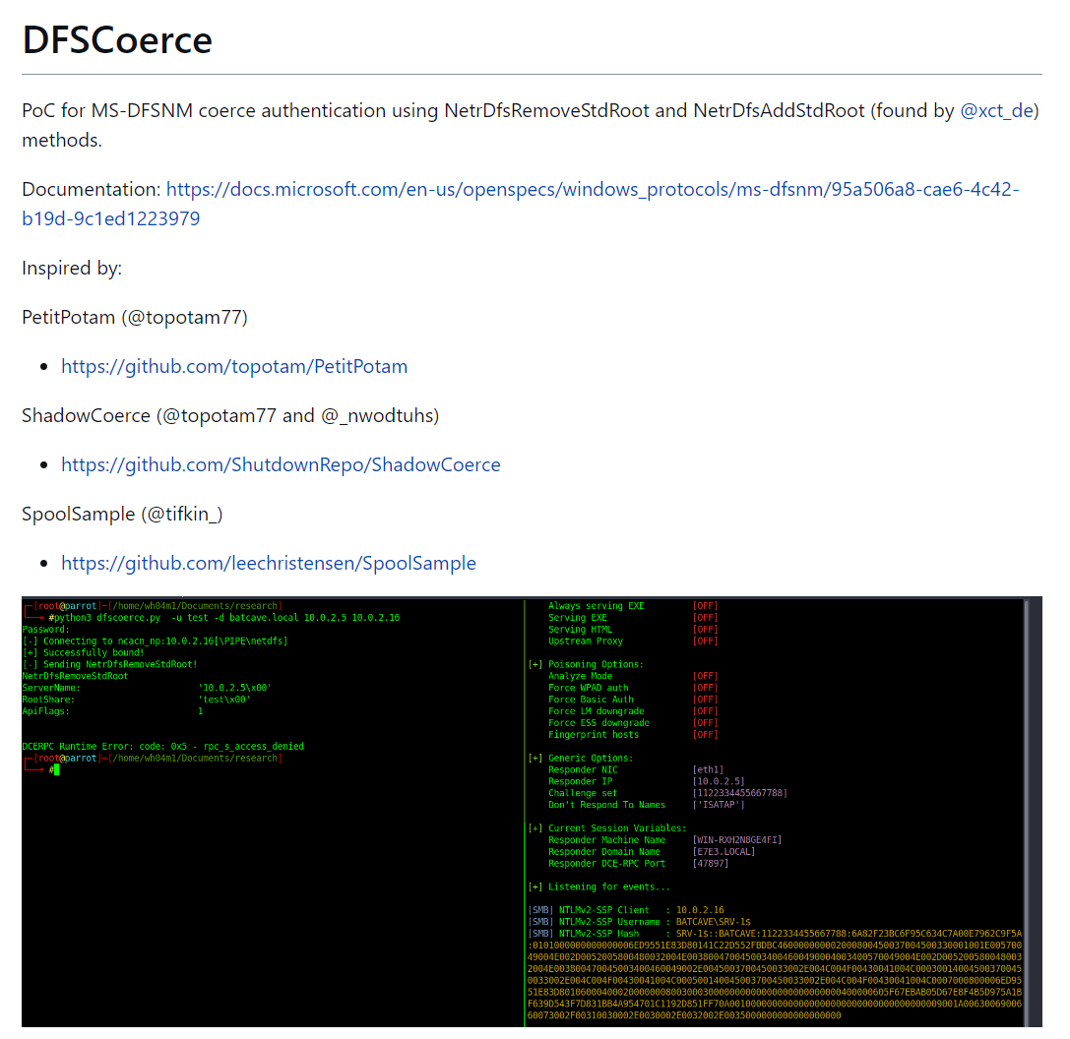
Coerced Authentication
Windows hosts really like to authenticate to stuff

Slide 80
Everything Else

Slide 81
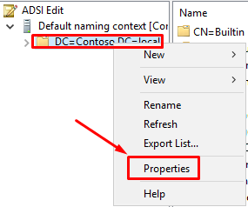
Machine Account Quota
Mitigate persistence mechanisms and abuse mechanism in one step!
Fix using ADSI Edit [14]

Slide 82
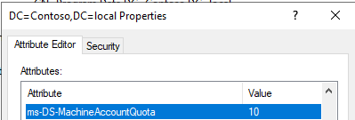
Machine Account Quota
Mitigate persistence mechanisms and abuse mechanism in one step!
Fix using ADSI Edit [14]

Slide 83
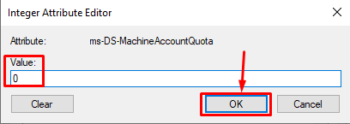
Machine Account Quota
Mitigate persistence mechanisms and abuse mechanism in one step!
Fix using ADSI Edit [14]

Slide 84
Machine Account Quota
Can also consider using the “SeMachineAccountPrivilege” privilege
This designates which identities can add machine accounts to a domain and
Possesses the “Authenticated Users” value by default.

Slide 85
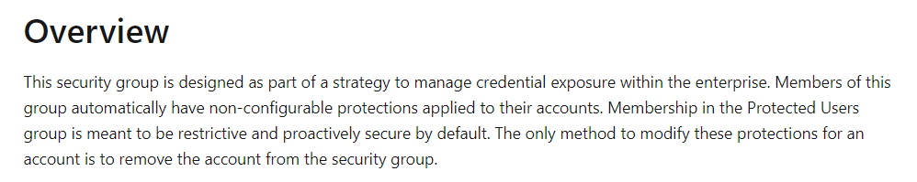
Protected Users Group
Best kept secret
Really really makes your life annoying as a pentester… which is good
Protected Users Security Group [15]

Slide 86
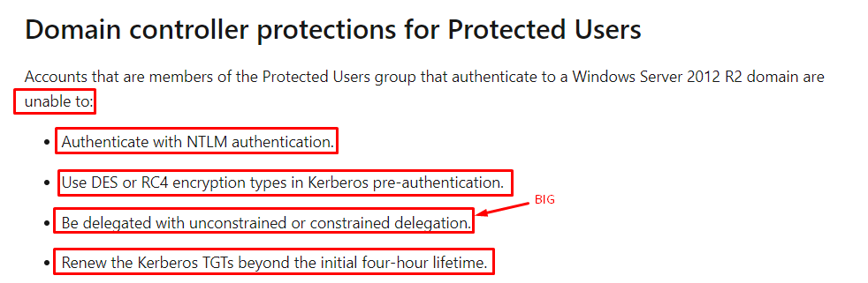
Protected Users Group
Protected Users Security Group [15]

Slide 87
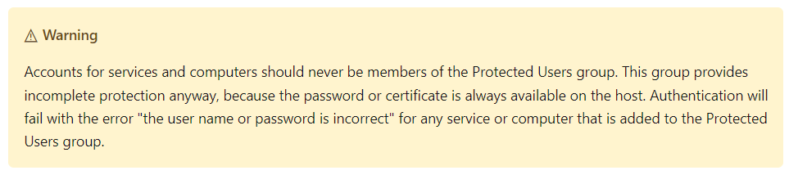
Protected Users Group
Protected Users Security Group [15]

Slide 88
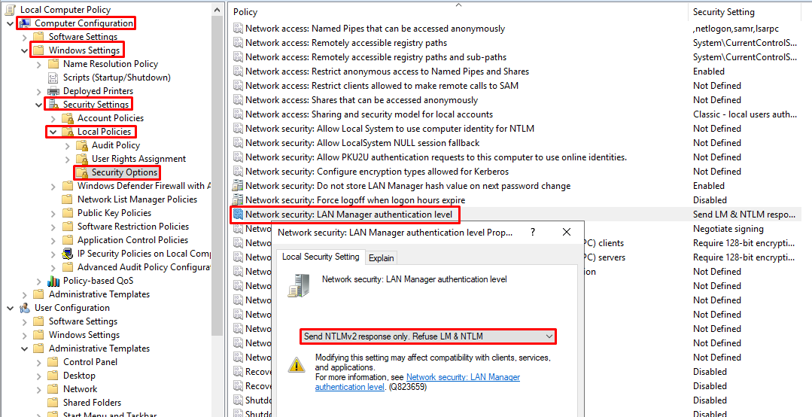
NTLM Downgrade [16]
Can sometimes downgrade authentication requests to outdated versions of NTLM
Rainbow tables, easier password cracking, relaying considerations all play a part

Slide 89
NTLM Downgrade [16]
Computer Configuration -> Windows Settings -> Security Settings -> Local Policies -> Security Options -> Network security: LAN Manager authentication level: Send NTLMv2 response only. Refuse LM & NTLM

Slide 90
So, what do I do?

Slide 91
So, what do I do?
Protect your targets

Slide 92
So, what do I do?
Protect your targets
Enable SMB signing

Slide 93
So, what do I do?
Protect your targets
Enable SMB signing
No… seriously

Slide 94
So, what do I do?
Protect your targets
Enable SMB signing
No… seriously
LDAP Channel Binding and Signing

Slide 95
So, what do I do?
Protect your targets
Enable SMB signing
No… seriously
LDAP Channel Binding and Signing
EPA -> ADCS

Slide 96
So, what do I do?
Protect your targets
Work towards reducing usage of insecure network protocols

Slide 97
So, what do I do?
Protect your targets
Work towards reducing usage of insecure network protocols
Pursue quick wins (high ROI)
Machine Account Quota
Protected Users Group

Slide 98
Further Reading
We did not talk about Active Directory in detail, although most of these attacks rely on its functionality
Active Directory security is a separate game, but not one you can’t win

Slide 99
Further Reading
We did not talk about Active Directory in detail, although most of these attacks rely on its functionality
Active Directory security is a separate game, but not one you can’t win
Or at least score points…

Slide 100

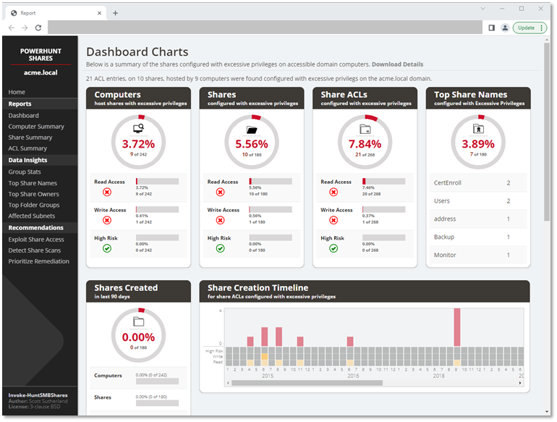

Further Reading
BloodHound
PowerHuntShares
PingCastle
Start here:
https://bloodhound.readthedocs.io/en/latest/index.html
Audit some file shares:
https://github.com/NetSPI/PowerHuntShares
Read more: https://www.pingcastle.com/
Grab a copy and start getting visibility!
https://github.com/vletoux/pingcastle/releases

Slide 101


Slides → https://github.com/0xAsh/media
Christian Hyatt
Security Team Operating System 14:00 – 14:50
Room 460 “Re-Ignite”
Ryan Basden
These Violent Delights: Burnout Recovery and Prevention 101 15:00 – 15:50

Slide 102
References
[1] https://byt3bl33d3r.github.io/practical-guide-to-ntlm-relaying-in-2017-aka-getting-a-foothold-in-under-5-minutes.html
[2] https://en.hackndo.com/ntlm-relay/
[3] https://www.blackhillsinfosec.com/how-to-disable-llmnr-why-you-want-to/
[4] https://www.blumira.com/integration/disable-llmnr-netbios-wpad-lm-hash/
[5] https://blog.fox-it.com/2018/01/11/mitm6-compromising-ipv4-networks-via-ipv6/
[6] https://www.lmgsecurity.com/mitigating-ipv6-poisoning-attacks/
[7] https://thehacker.recipes/ad/movement/ntlm/relay
[8] https://docs.microsoft.com/en-us/previous-versions/system-center/operations-manager-2005/cc180803(v=technet.10)
[9] https://www.thehacker.recipes/ad/movement/ntlm/relay
[10] https://twitter.com/_nwodtuhs
[11] https://support.microsoft.com/en-us/topic/use-the-ldapenforcechannelbinding-registry-entry-to-make-ldap-authentication-over-ssl-tls-more-secure-e9ecfa27-5e57-8519-6ba3-d2c06b21812e
[12] https://www.specterops.io/assets/resources/Certified_Pre-Owned.pdf
[13] https://support.microsoft.com/en-us/topic/kb5005413-mitigating-ntlm-relay-attacks-on-active-directory-certificate-services-ad-cs-3612b773-4043-4aa9-b23d-b87910cd3429
[14] https://www.jorgebernhardt.com/how-to-change-attribute-ms-ds-machineaccountquota/
[15] https://docs.microsoft.com/en-us/windows-server/security/credentials-protection-and-management/protected-users-security-group
[16] https://www.thehacker.recipes/ad/movement/ntlm/capture

